Slide 1
LIFE/work balance
We have started a #LIFEworkbalance campaign and we need your help to complete our LIFE/work balance survey.
We hope to publish the results soon, so please give 15 minutes of your time to help us get a true picture of school life.
Want to be a part of this campaign? Take the survey on our website and share it with your colleagues!
© Classroom Secrets Limited 2020

Slide 2
Year 6 – Spring Block 4 – Converting Units – Convert Metric Measures
About This Resource:
This PowerPoint has been designed to support your teaching of this small step. It includes a starter activity and an example of each question from the Varied Fluency and Reasoning and Problem Solving resources also provided in this pack. You can choose to work through all examples provided or a selection of them depending on the needs of your class.
National Curriculum Objectives:
Mathematics Year 6: (6M5) Use, read, write and convert between standard units, converting measurements of length, mass, volume and time from a smaller unit of measure to a larger unit, and vice versa, using decimal notation to up to three decimal places
Mathematics Year 6: (6M9) Solve problems involving the calculation and conversion of units of measure, using decimal notation up to three decimal places where appropriate
More Year 6 Converting Units resources.
Did you like this resource? Don’t forget to review it on our website.
© Classroom Secrets Limited 2019

Slide 3
Year 6 – Spring Block 4 – Converting Units
Step 2: Convert Metric Measures
© Classroom Secrets Limited 2019

Slide 4
Introduction
Match the item to the most appropriate unit of measurement.
Weight of a sack of potatoes |  | L
Volume of water in a glass |  | mm
Length of a park |  | cm
Length of a finger |  | m
Weight of an apple |  | ml
Volume of water in a bucket |  | g
Length of an ant’s leg |  | kg
© Classroom Secrets Limited 2019

Slide 5
Introduction
Match the item to the most appropriate unit of measurement.
Weight of a sack of potatoes |  | kg
Volume of water in a glass |  | ml
Length of a park |  | m
Length of a finger |  | cm
Weight of an apple |  | g
Volume of water in a bucket |  | L
Length of an ant’s leg |  | mm
© Classroom Secrets Limited 2019

Slide 6
Varied Fluency 1
Complete the following statement.
3,500ml is equal to ____L.
© Classroom Secrets Limited 2019

Slide 7
Varied Fluency 1
Complete the following statement.
3,500ml is equal to ____L.
3.5
© Classroom Secrets Limited 2019

Slide 8
Varied Fluency 2
Put these measurements in order from smallest to largest.
155cm
2.6m
0.6m
1,050mm
155mm
165cm
© Classroom Secrets Limited 2019

Slide 9
Varied Fluency 2
Put these measurements in order from smallest to largest.
155mm; 0.6m; 1,050mm; 155cm; 165cm; 2.6m
155cm
2.6m
0.6m
1,050mm
155mm
165cm
© Classroom Secrets Limited 2019

Slide 10
Varied Fluency 3
Complete the missing operation and measurement to convert between g and kg.
285g |  | = |  | kg
© Classroom Secrets Limited 2019

Slide 11
Varied Fluency 3
Complete the missing operation and measurement to convert between g and kg.
285g | ÷ 1,000 | = | 0.285 | kg
© Classroom Secrets Limited 2019

Slide 12
Varied Fluency 4
Find and correct the errors in these conversions:
A. | 1,565g | = | 1.565kg
B. | 2.35L | = | 235ml
C. | 15cm | = | 150mm
D. | 1,500mm | = | 1.05m
© Classroom Secrets Limited 2019

Slide 13
Varied Fluency 4
Find and correct the errors in these conversions:
A. | 1,565g | = | 1.565kg
B. | 2.35L | = | 2,350ml
C. | 15cm | = | 150mm
D. | 1,500mm | = | 1.5m
© Classroom Secrets Limited 2019

Slide 14
Reasoning 1
Roland thinks that he walked the farthest on Wednesday.
Do you agree? Explain why.
 | 9am | 12pm | 3pm
Mon | 3.565km | 2,425m | 2,475m
Tue | 1.5km | 1,050m | 5,255m
Wed | 6,065m | 2km | 500m
Thu | 4,650m | 3.05km | 1,455m
Fri | 2.075km | 50m | 3,615m
© Classroom Secrets Limited 2019

Slide 15
Reasoning 1
Roland thinks that he walked the farthest on Wednesday.
Do you agree? Explain why.
Roland is incorrect because…
 | 9am | 12pm | 3pm
Mon | 3.565km | 2,425m | 2,475m
Tue | 1.5km | 1,050m | 5,255m
Wed | 6,065m | 2km | 500m
Thu | 4,650m | 3.05km | 1,455m
Fri | 2.075km | 50m | 3,615m
© Classroom Secrets Limited 2019

Slide 16
Reasoning 1
Roland thinks that he walked the farthest on Wednesday.
Do you agree? Explain why.
Roland is incorrect because he walked 9.155km (9,155m) on Thursday, which is farther than any other day.
 | 9am | 12pm | 3pm
Mon | 3.565km | 2,425m | 2,475m
Tue | 1.5km | 1,050m | 5,255m
Wed | 6,065m | 2km | 500m
Thu | 4,650m | 3.05km | 1,455m
Fri | 2.075km | 50m | 3,615m
total
8.465km
7.805km
8.565km
9.155km
5.74km
© Classroom Secrets Limited 2019

Slide 17
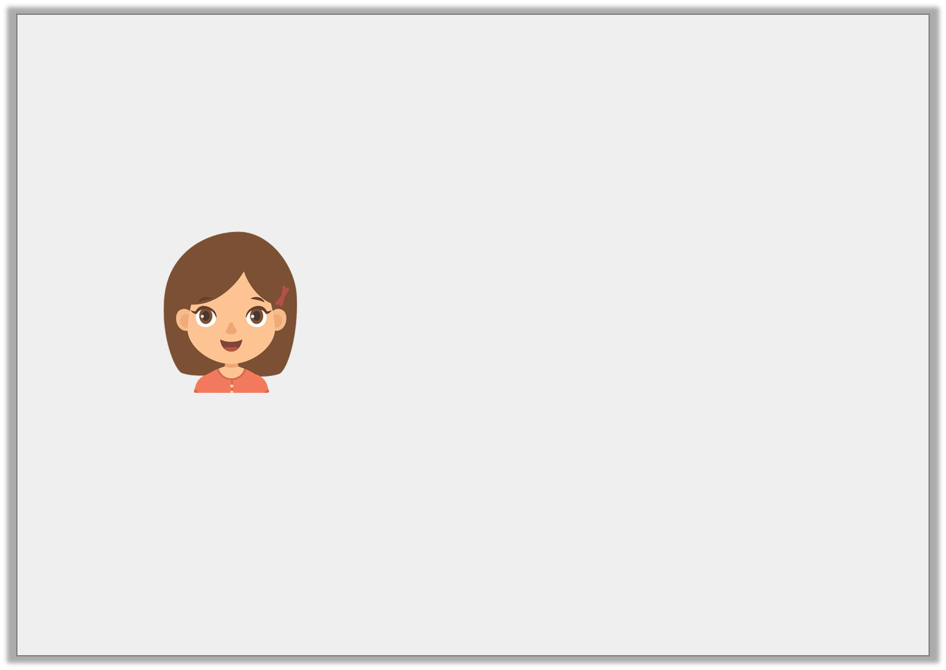
Problem Solving 1
Erin is practicing converting different units of measure.
She says,
What could her starting number have been? Find 3 possibilities.
I start off with a number of millilitres. When converted to litres, my amount has 2 decimal places and is between 6.3L and 6.4L.
© Classroom Secrets Limited 2019

Slide 18
Problem Solving 1
Erin is practicing converting different units of measure.
She says,
What could her starting number have been? Find 3 possibilities.
Various answers, for example: 6,310ml (6.31L); 6,320ml (6.32L); 6,330ml (6.33L)
I start off with a number of millilitres. When converted to litres, my amount has 2 decimal places and is between 6.3L and 6.4L.
© Classroom Secrets Limited 2019

Slide 19
Reasoning 2
Harry has filled in a table after converting from cm to m.
Is his table correct? Explain why.
cm | m
302cm | 3.2m
1,204cm | 12.4m
4,305cm | 43.5m
© Classroom Secrets Limited 2019

Slide 20
Reasoning 2
Harry has filled in a table after converting from cm to m.
Is his table correct? Explain why.
Harry’s table is incorrect because…
cm | m
302cm | 3.02m
1,204cm | 12.04m
4,305cm | 43.05m
© Classroom Secrets Limited 2019

Slide 21
Reasoning 2
Harry has filled in a table after converting from cm to m.
Is his table correct? Explain why.
Harry’s table is incorrect because he has not included the zero as a placeholder when converting.
cm | m
302cm | 3.02m
1,204cm | 12.04m
4,305cm | 43.05m
© Classroom Secrets Limited 2019

